Slide 1
Section 8.1
Mathematical Modeling with Differential Equations

Slide 2
All graphics are attributed to:
Calculus,10/E by Howard Anton, Irl Bivens, and Stephen Davis
Copyright © 2009 by John Wiley & Sons, Inc. All rights reserved.

Slide 3
Introduction
Many fundamental laws of science and engineering can be expressed in terms of differential equations.
We introduced the concept last class, today we will go into more detail.
We will discuss some important mathematical models that involve differential equations, and discuss some methods for solving and approximating solutions of some basic differential equations.
Note: There are entire courses in college devoted to differential equations.

Slide 4
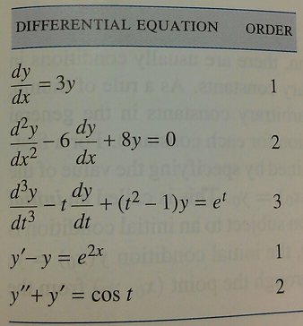
Terminology
A differential equation is an equation involving one or more derivatives of an unknown function (we will use y = y(x) unless it is a function of time, for which we will use y = y(t)).
The order of a differential equation is the order of the highest derivative that it contains.
In the table at the right, for example,
the highest order derivative in the last
equation y” + y’ = cos t is y” comes from
the y” term. Therefore, the order is 2
since it is the second derivative.

Slide 5
Solutions of Differential Equations
A function y = y(x) is a solution of a differential equation on an open interval if the equation is satisfied identically on the interval when y and its derivatives are substituted into the equation.
Example: y = e ^{2x} is a solution of dy/dx – y = e ^{2x} because it “works” when we substitute y = e ^{2x} and its derivative dy/dx = e ^{2x} * 2 (don’t forget chain rule).
  dy/dx – y = e ^{2x}
  2 e ^{2x} - e ^{2x} = e ^{2x} substitution
  2 e ^{2x} - 1e ^{2x} = e ^{2x} put in coefficient 1
  1e ^{2x} = e ^{2x} combine like terms

Slide 6
General Solutions of Differential Equations
While we saw on the last slide that y = e ^{2x} is a solution of dy/dx – y = e ^{2x}, it is not the only solution that “works” when we substitute y and its derivative dy/dx into dy/dx – y = e ^{2x}. y = e ^{2x} +Ce ^{x} (general solution, see below) is also a solution for every real value of the constant C.
  dy/dx – y = e ^{2x}
  2 e ^{2x} + Ce ^{x} – (e ^{2x} +Ce ^{x}) = e ^{2x} substitution
  2 e ^{2x} + Ce ^{x} – 1e ^{2x} - Ce ^{x} = e ^{2x} distribute & put in coeff. 1
  1e ^{2x} + 0 = e ^{2x} combine like terms
On a given interval, a solution of a differential equation from which all solutions on that interval can be derived by substituting values for arbitrary constants is called a general solution of the equation on the interval.

Slide 7
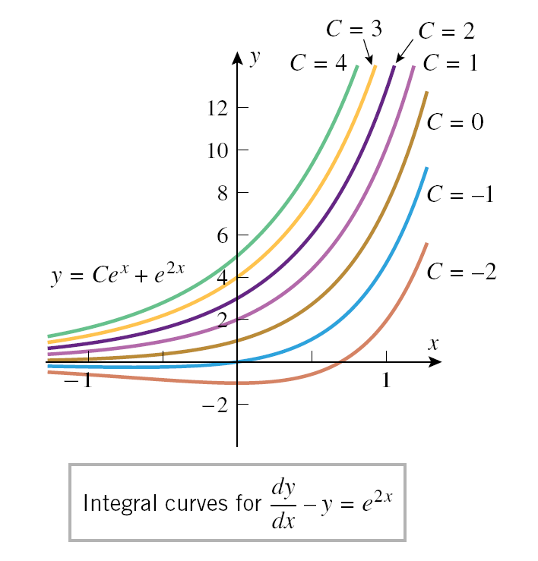
Integral Curve
The graph of a solution of a differential equation is called an integral curve for the equation.
It is often a family of integral curves corresponding to the different possible choices for C.
Some integral curves for the example we
have been discussing:

Slide 8
Initial-Value Problems
When an applied problem leads to a differential equation (examples to follow), there are usually conditions in the problem that determine specific values for the arbitrary constants.
As a rule of thumb, it requires one condition for each constant to be able to solve.
For a first order equations, the initial condition is often given y(x₀) = y₀.
This is called solving a first-order initial-value problem and it forces the solution to be the integral curve which passes through the point (x_{0,} y₀).

Slide 9
Example of a First-Order Initial-Value Problem
Find the solution to the differential equation we were using earlier dy/dx – y = e ^{2x} which has an initial value of 3 (means y(0) = 3 and point is (0,3)).
  y = e ^{2x} +Ce ^{x} general solution from slide #6
  3 = e ²⁽⁰⁾ +Ce ⁽⁰⁾ substitution (0,3)
  3 = e ⁰+Ce ⁰ multiply
  3 = 1+C*1 n ⁰ = 1, NOTE: 0 ⁰ is undefined
  2 = C solve for C
  y = e ^{2x} +2e ^{x} specific solution through (0,3)

Slide 10
Applications
Since many important principles in the physical and social sciences involve rates of change, the principals can often be modeled by differential equations.
Some examples we will discuss now are:
  Uninhibited Population Growth
  Pharmacology
  Spread of Disease
  Newton’s Law of Cooling
  Vibrations of Springs

Slide 11
Uninhibited Population Growth
One of the simplest models of population growth is based on the observation that when populations (people, plants, bacteria, and fruit flies for example) are not constrained by environmental limitations, they tend to grow at a rate (called dy/dt) that is proportional to the size of the population-the larger the population, the more rapidly it grows.
This is described by the differential equation:
  dy/dt = ky
If you know the population at some point, we can obtain a formula for the population by solving the initial-value problem as we did on slide #9:
  dy/dt = ky, y(0) = y0

Slide 12
Inhibited Population Growth; Logistic Models
Uninhibited population growth is only reasonable as long as the size of a population is relatively small, environmental effects become increasingly important as the population grows because an ecological system can only support a certain number of individuals, L.
L is called the carrying capacity of the system.
When the population (y) is bigger than the carrying capacity (y>L), the population tends to decrease toward L.
When y<L, the population is below capacity and tends to increase towards L.
When y=L, the population is in balance with the ecological systems and tends to remain stable.

Slide 13
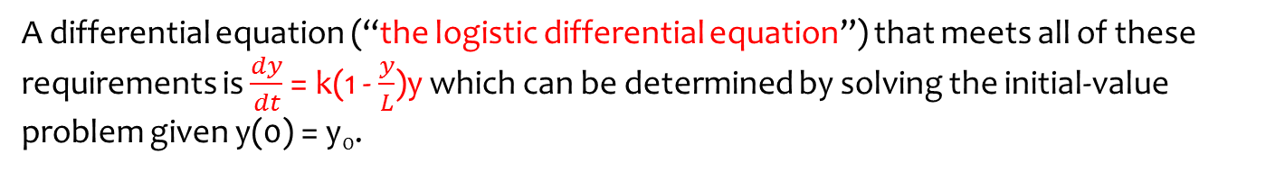
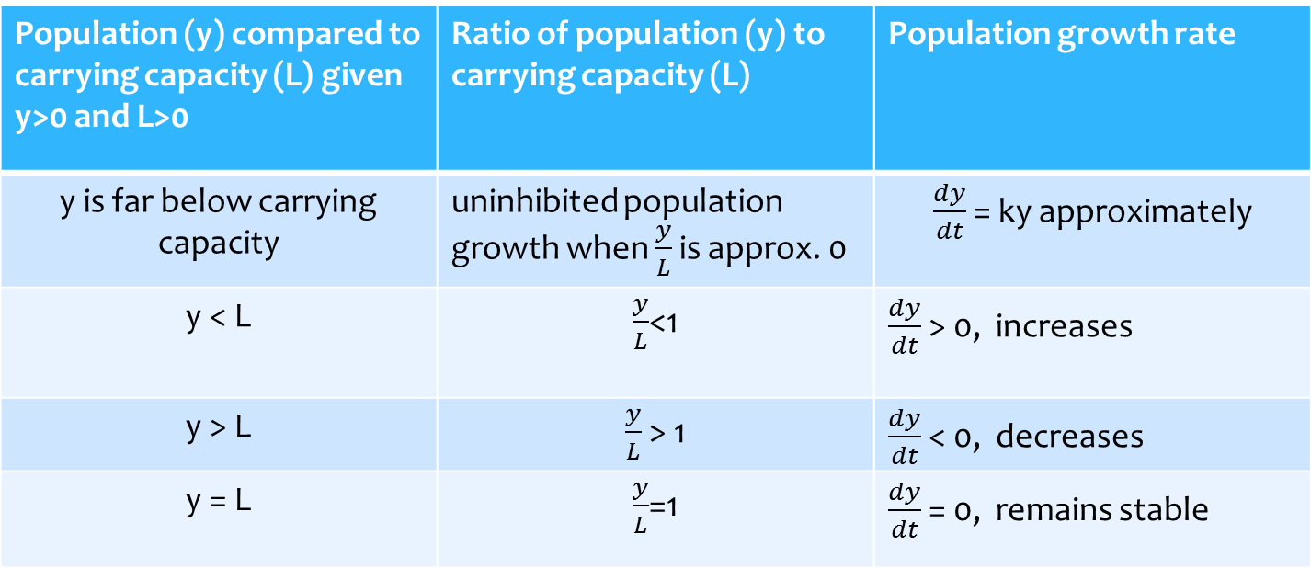
Population Growth; Logistic Model Mathematically
Population (y) compared to carrying capacity (L) given y>0 and L>0 | Ratio of population (y) to carrying capacity (L) | Population growth rate
y is far below carrying capacity | uninhibited population growth when $\frac{y}{L}$ is approx. 0 | $\frac{dy}{dt}$ = ky approximately
y < L | $\frac{y}{L}$<1 | $\frac{dy}{dt}$ > 0, increases
y > L | $\frac{y}{L}$ > 1 | $\frac{dy}{dt}$ < 0, decreases
y = L | $\frac{y}{L}$=1 | $\frac{dy}{dt}$ = 0, remains stable
A differential equation (“the logistic differential equation”) that meets all of these requirements is $\frac{dy}{dt}$ = k(1 - $\frac{y}{L}$)y which can be determined by solving the initial-value problem given y(0) = y₀.

Slide 14
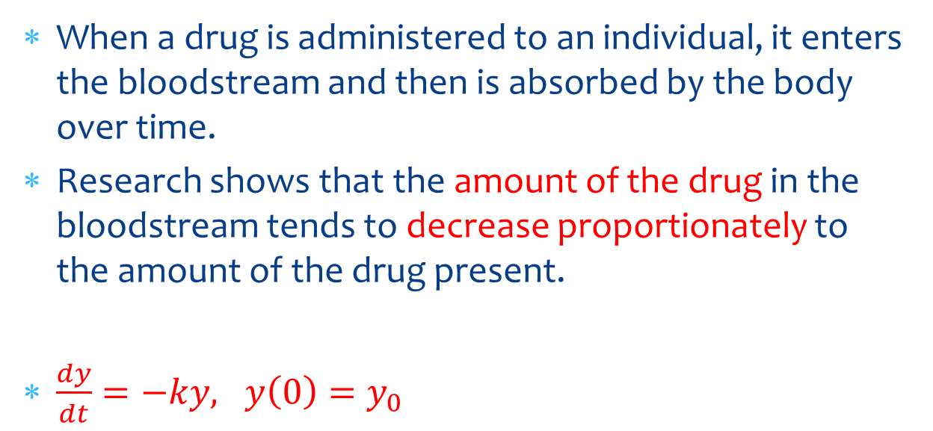
Pharmacology
When a drug is administered to an individual, it enters the bloodstream and then is absorbed by the body over time.
Research shows that the amount of the drug in the bloodstream tends to decrease proportionately to the amount of the drug present.
$\frac{dy}{dt}=−ky, y\left(0\right)=y_{0}$

Slide 15
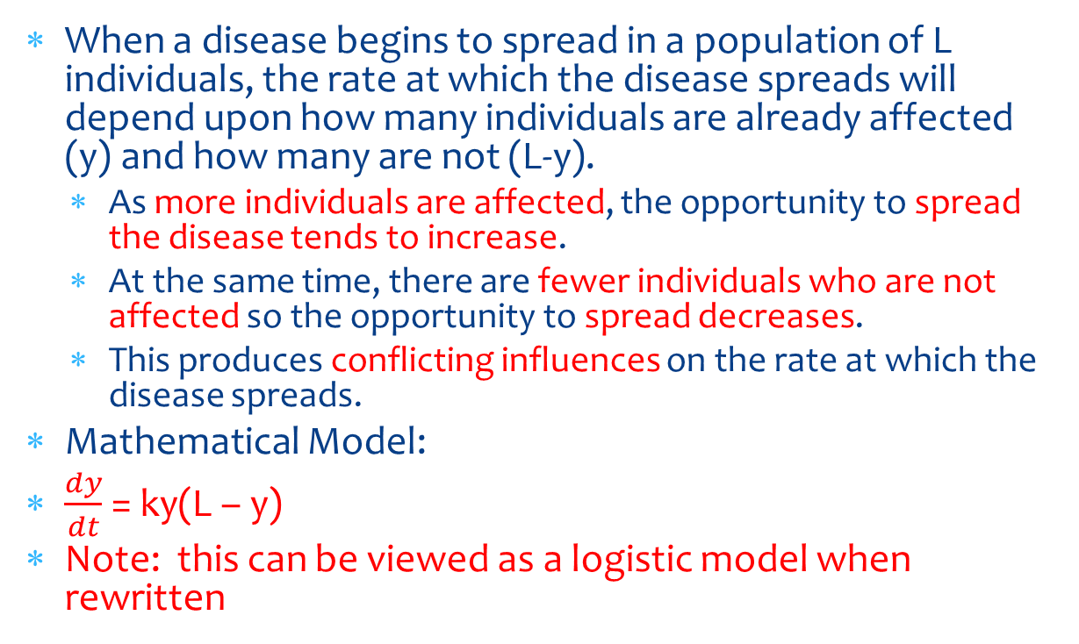
Spread of Disease
When a disease begins to spread in a population of L individuals, the rate at which the disease spreads will depend upon how many individuals are already affected (y) and how many are not (L-y).
  As more individuals are affected, the opportunity to spread the disease tends to increase.
  At the same time, there are fewer individuals who are not affected so the opportunity to spread decreases.
  This produces conflicting influences on the rate at which the disease spreads.
Mathematical Model:
$\frac{dy}{dt}$ = ky(L – y)
Note: this can be viewed as a logistic model when rewritten

Slide 16
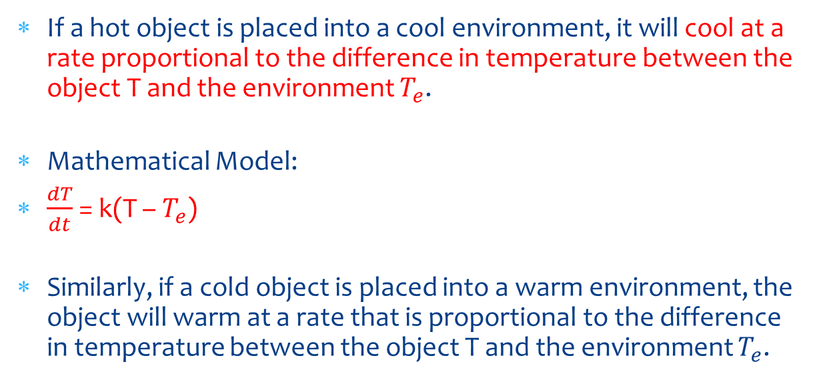
Newton’s Law of Cooling
If a hot object is placed into a cool environment, it will cool at a rate proportional to the difference in temperature between the object T and the environment $T_{e}$.
Mathematical Model:
$\frac{dT}{dt}$ = k(T – $T_{e}$)
Similarly, if a cold object is placed into a warm environment, the object will warm at a rate that is proportional to the difference in temperature between the object T and the environment $T_{e}$.

Slide 17
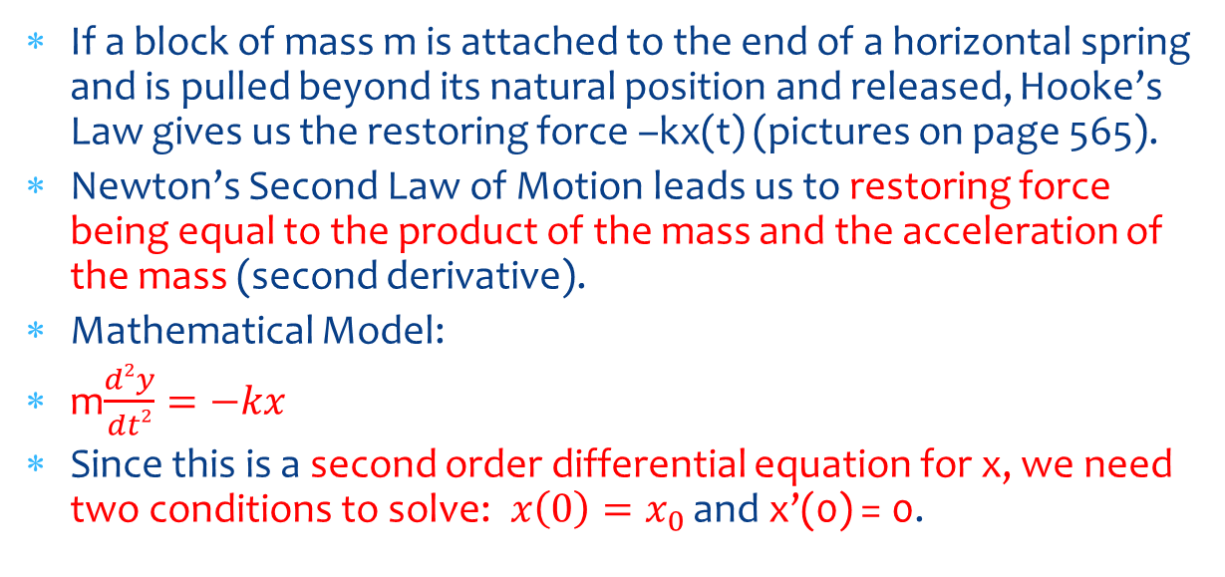
Vibrations of Springs
If a block of mass m is attached to the end of a horizontal spring and is pulled beyond its natural position and released, Hooke’s Law gives us the restoring force –kx(t) (pictures on page 565).
Newton’s Second Law of Motion leads us to restoring force being equal to the product of the mass and the acceleration of the mass (second derivative).
Mathematical Model:
m$\frac{d2y}{dt2}=−kx$
Since this is a second order differential equation for x, we need two conditions to solve:$x\left(0\right)=x_{0}$ and x’(0) = 0.

